Slide 1
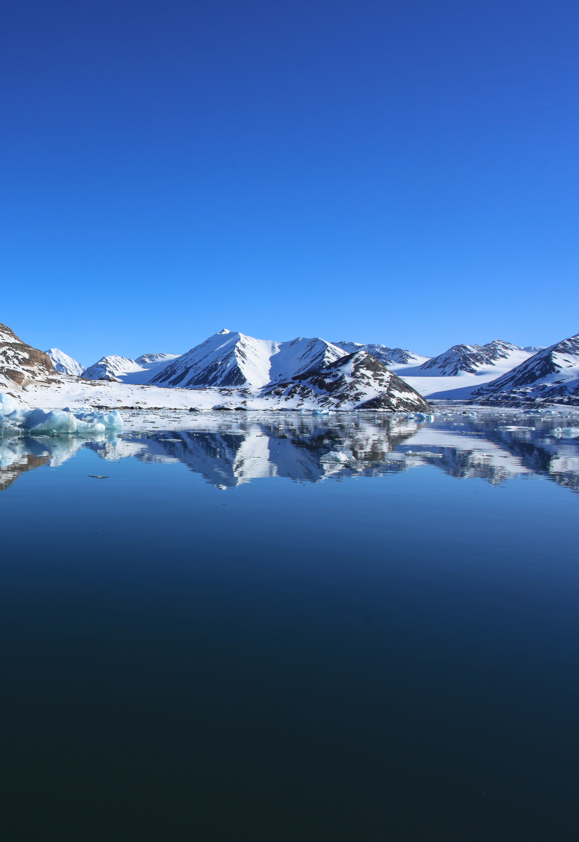

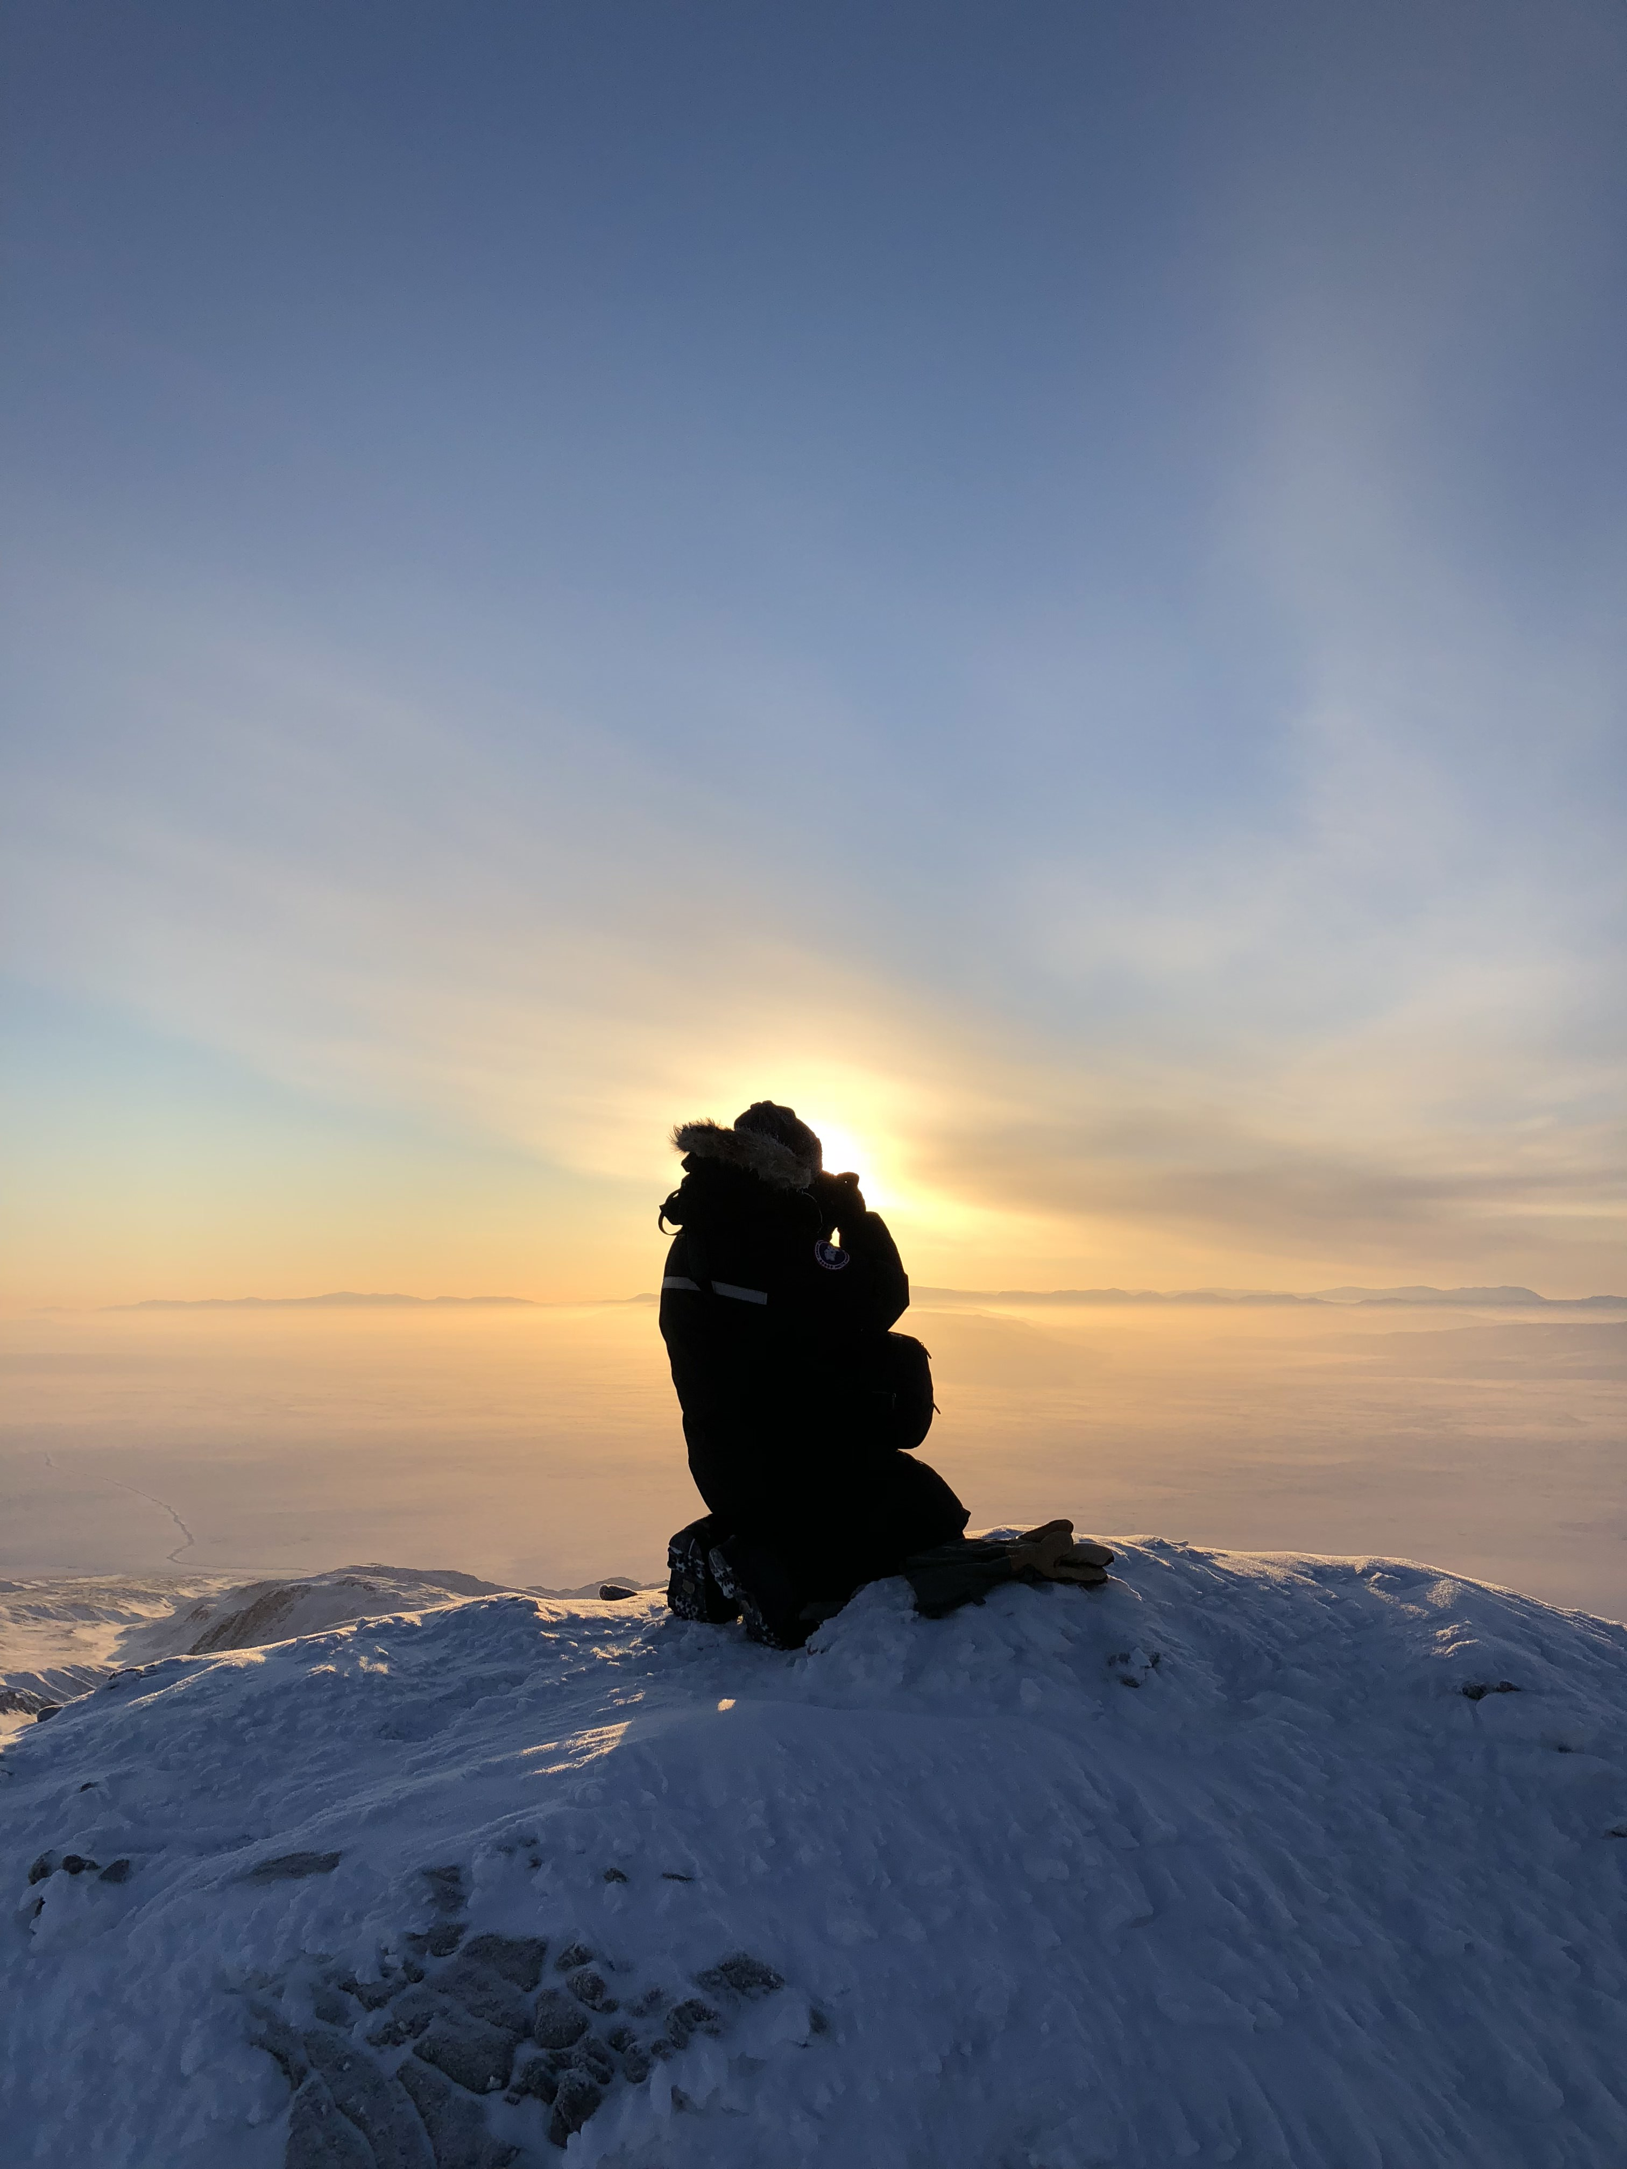


Agenda
1:00 PM – Tech troubleshooting
1:10 PM – Welcome
1:15 PM – Agenda
1:20 PM – Overview
  Presentation of the program
  Eligibility
  Key dates
  Application process
  Elements of a strong proposal
  Budget considerations
  Génome Québec Partnership
  Resources & support
1:40 PM – Questions & discussion
2:30 PM – Closing
Partnered Research Program
Call for Proposals 2024 : Overview and Q&A
November 7th 2024, 1pm

Slide 2
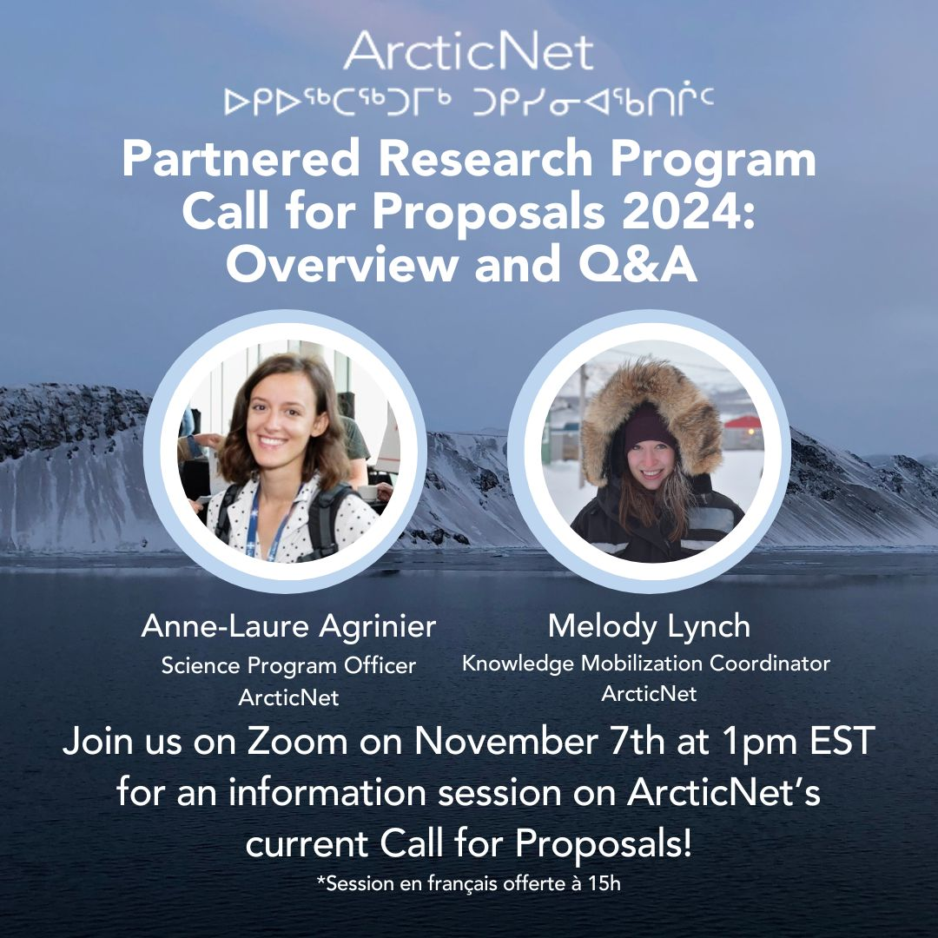
Welcome !
Webinar
Partnered Research Program
Call for Proposals 2024
Anne-Laure Agrinier
Science Program Officer
ArcticNet
Melody Lynch
Knowledge Mobilization Coordinator
ArcticNet

Slide 3
Agenda
Agenda
1:00 PM – Tech troubleshooting
1:10 PM – Welcome
1:15 PM – Agenda
1:20 PM – Overview
  Presentation of the program
  Eligibility
  Key dates
  Application process (demo, complete proposal, evaluation criteria)
  Elements of a strong proposal
  Budget considerations
  Génome Québec Partnership
  Resources & support
1:40 PM – Questions & discussion
2:30 PM – Closing

Slide 4
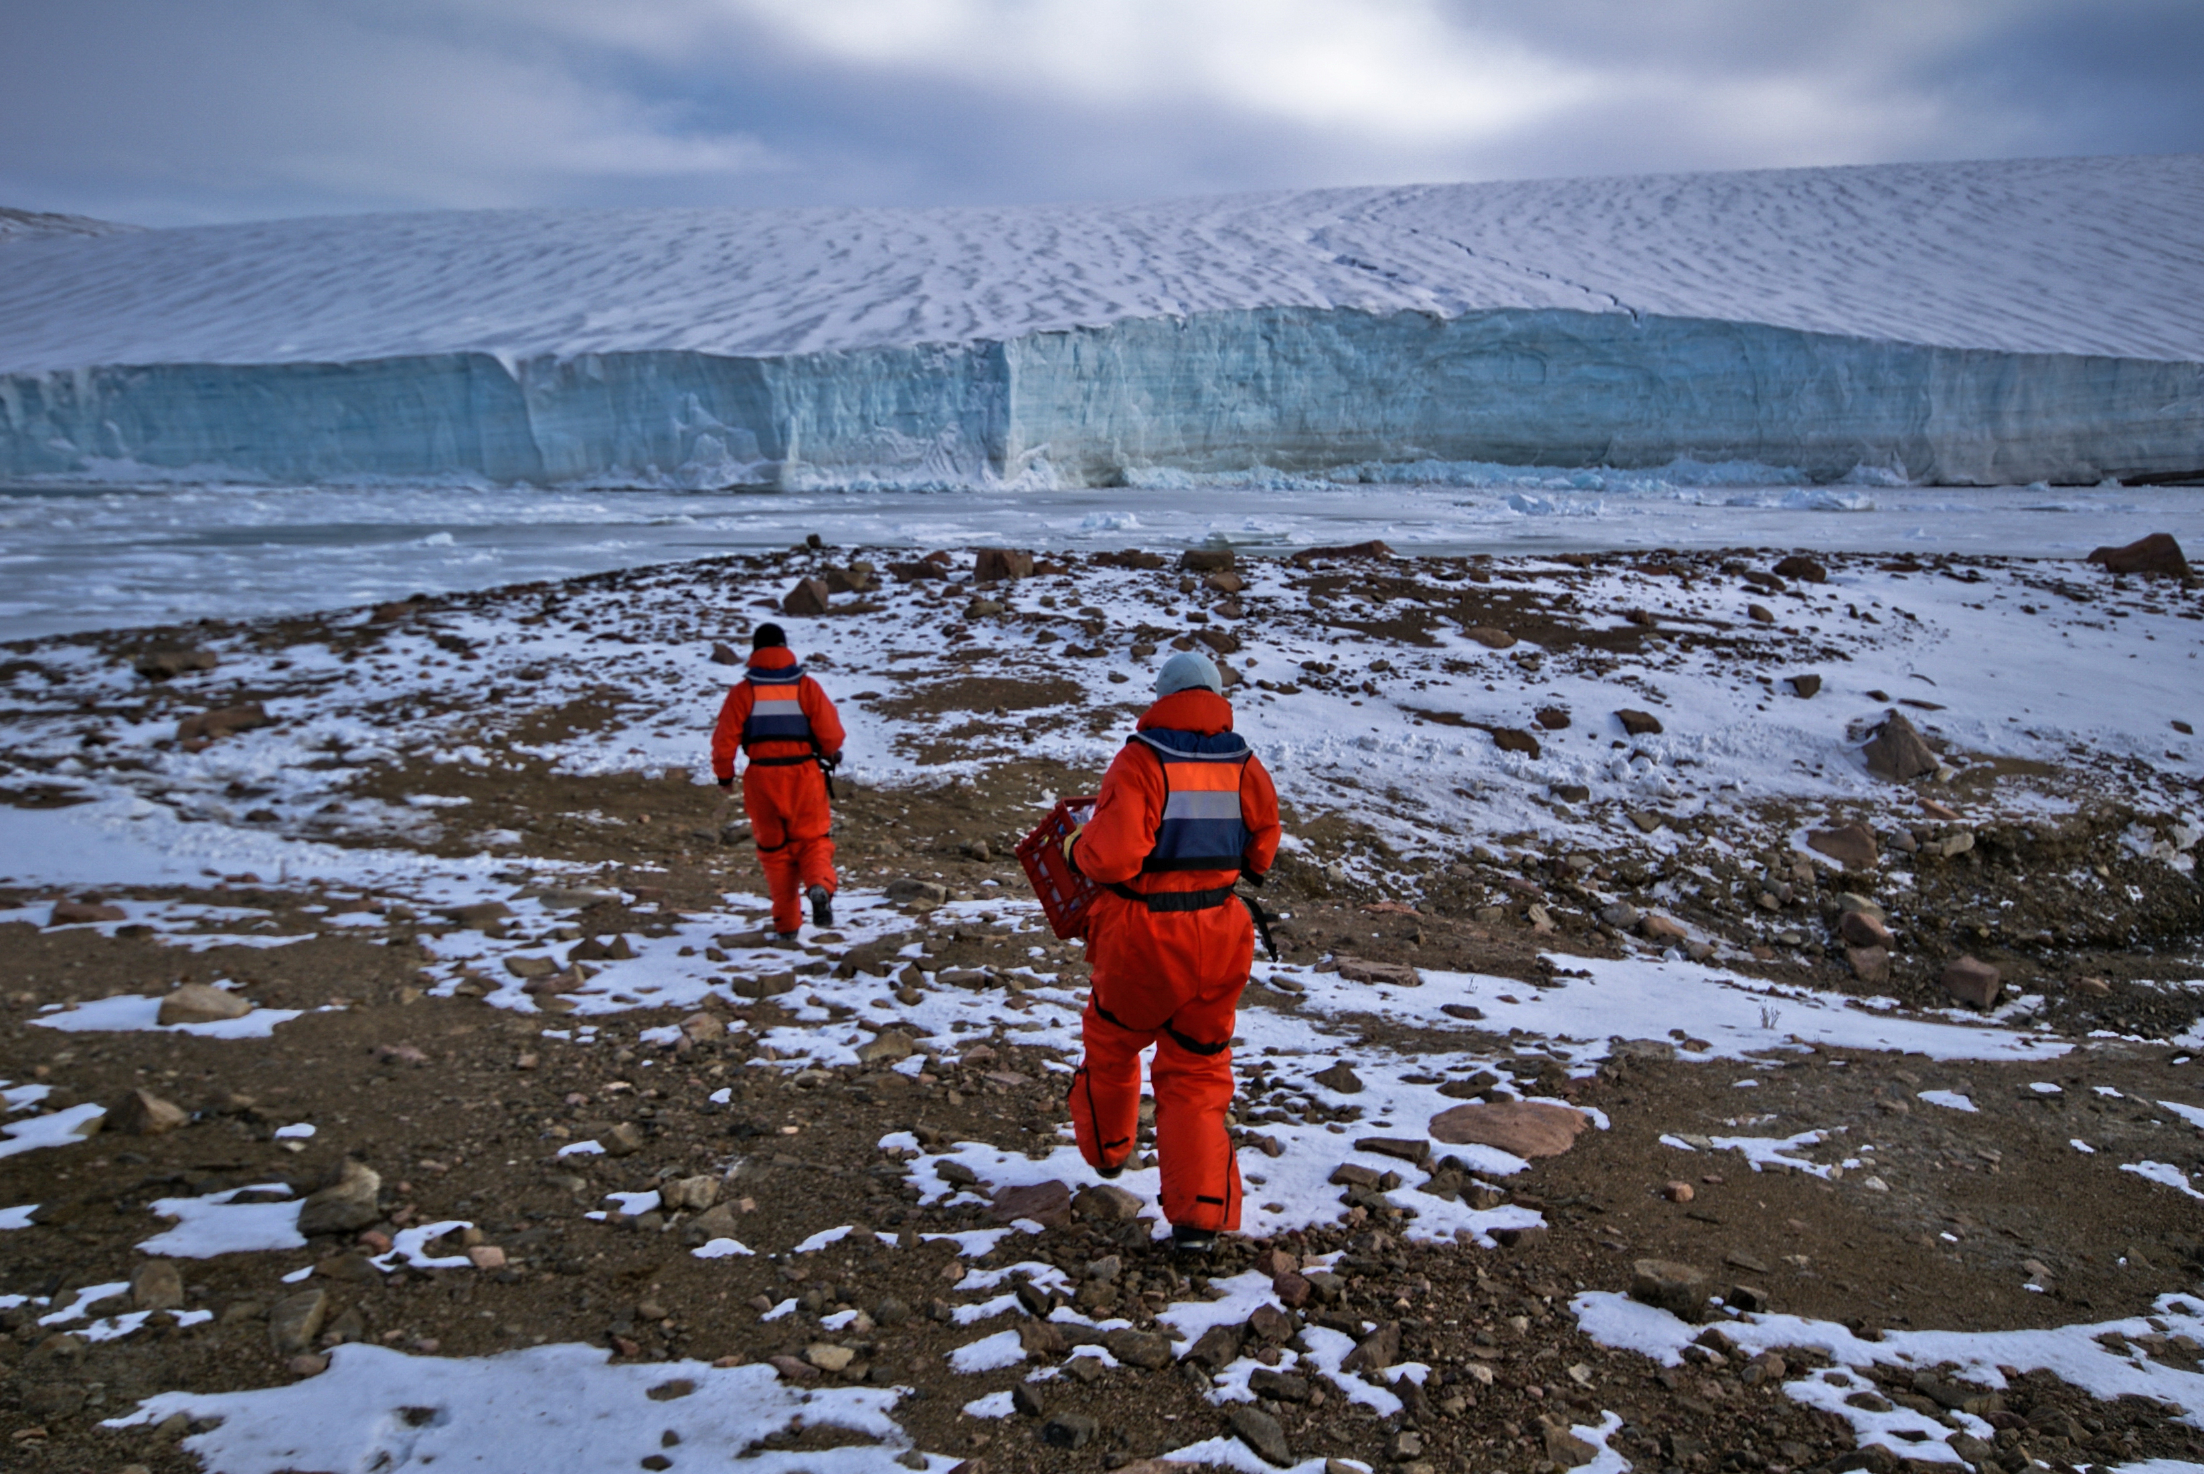
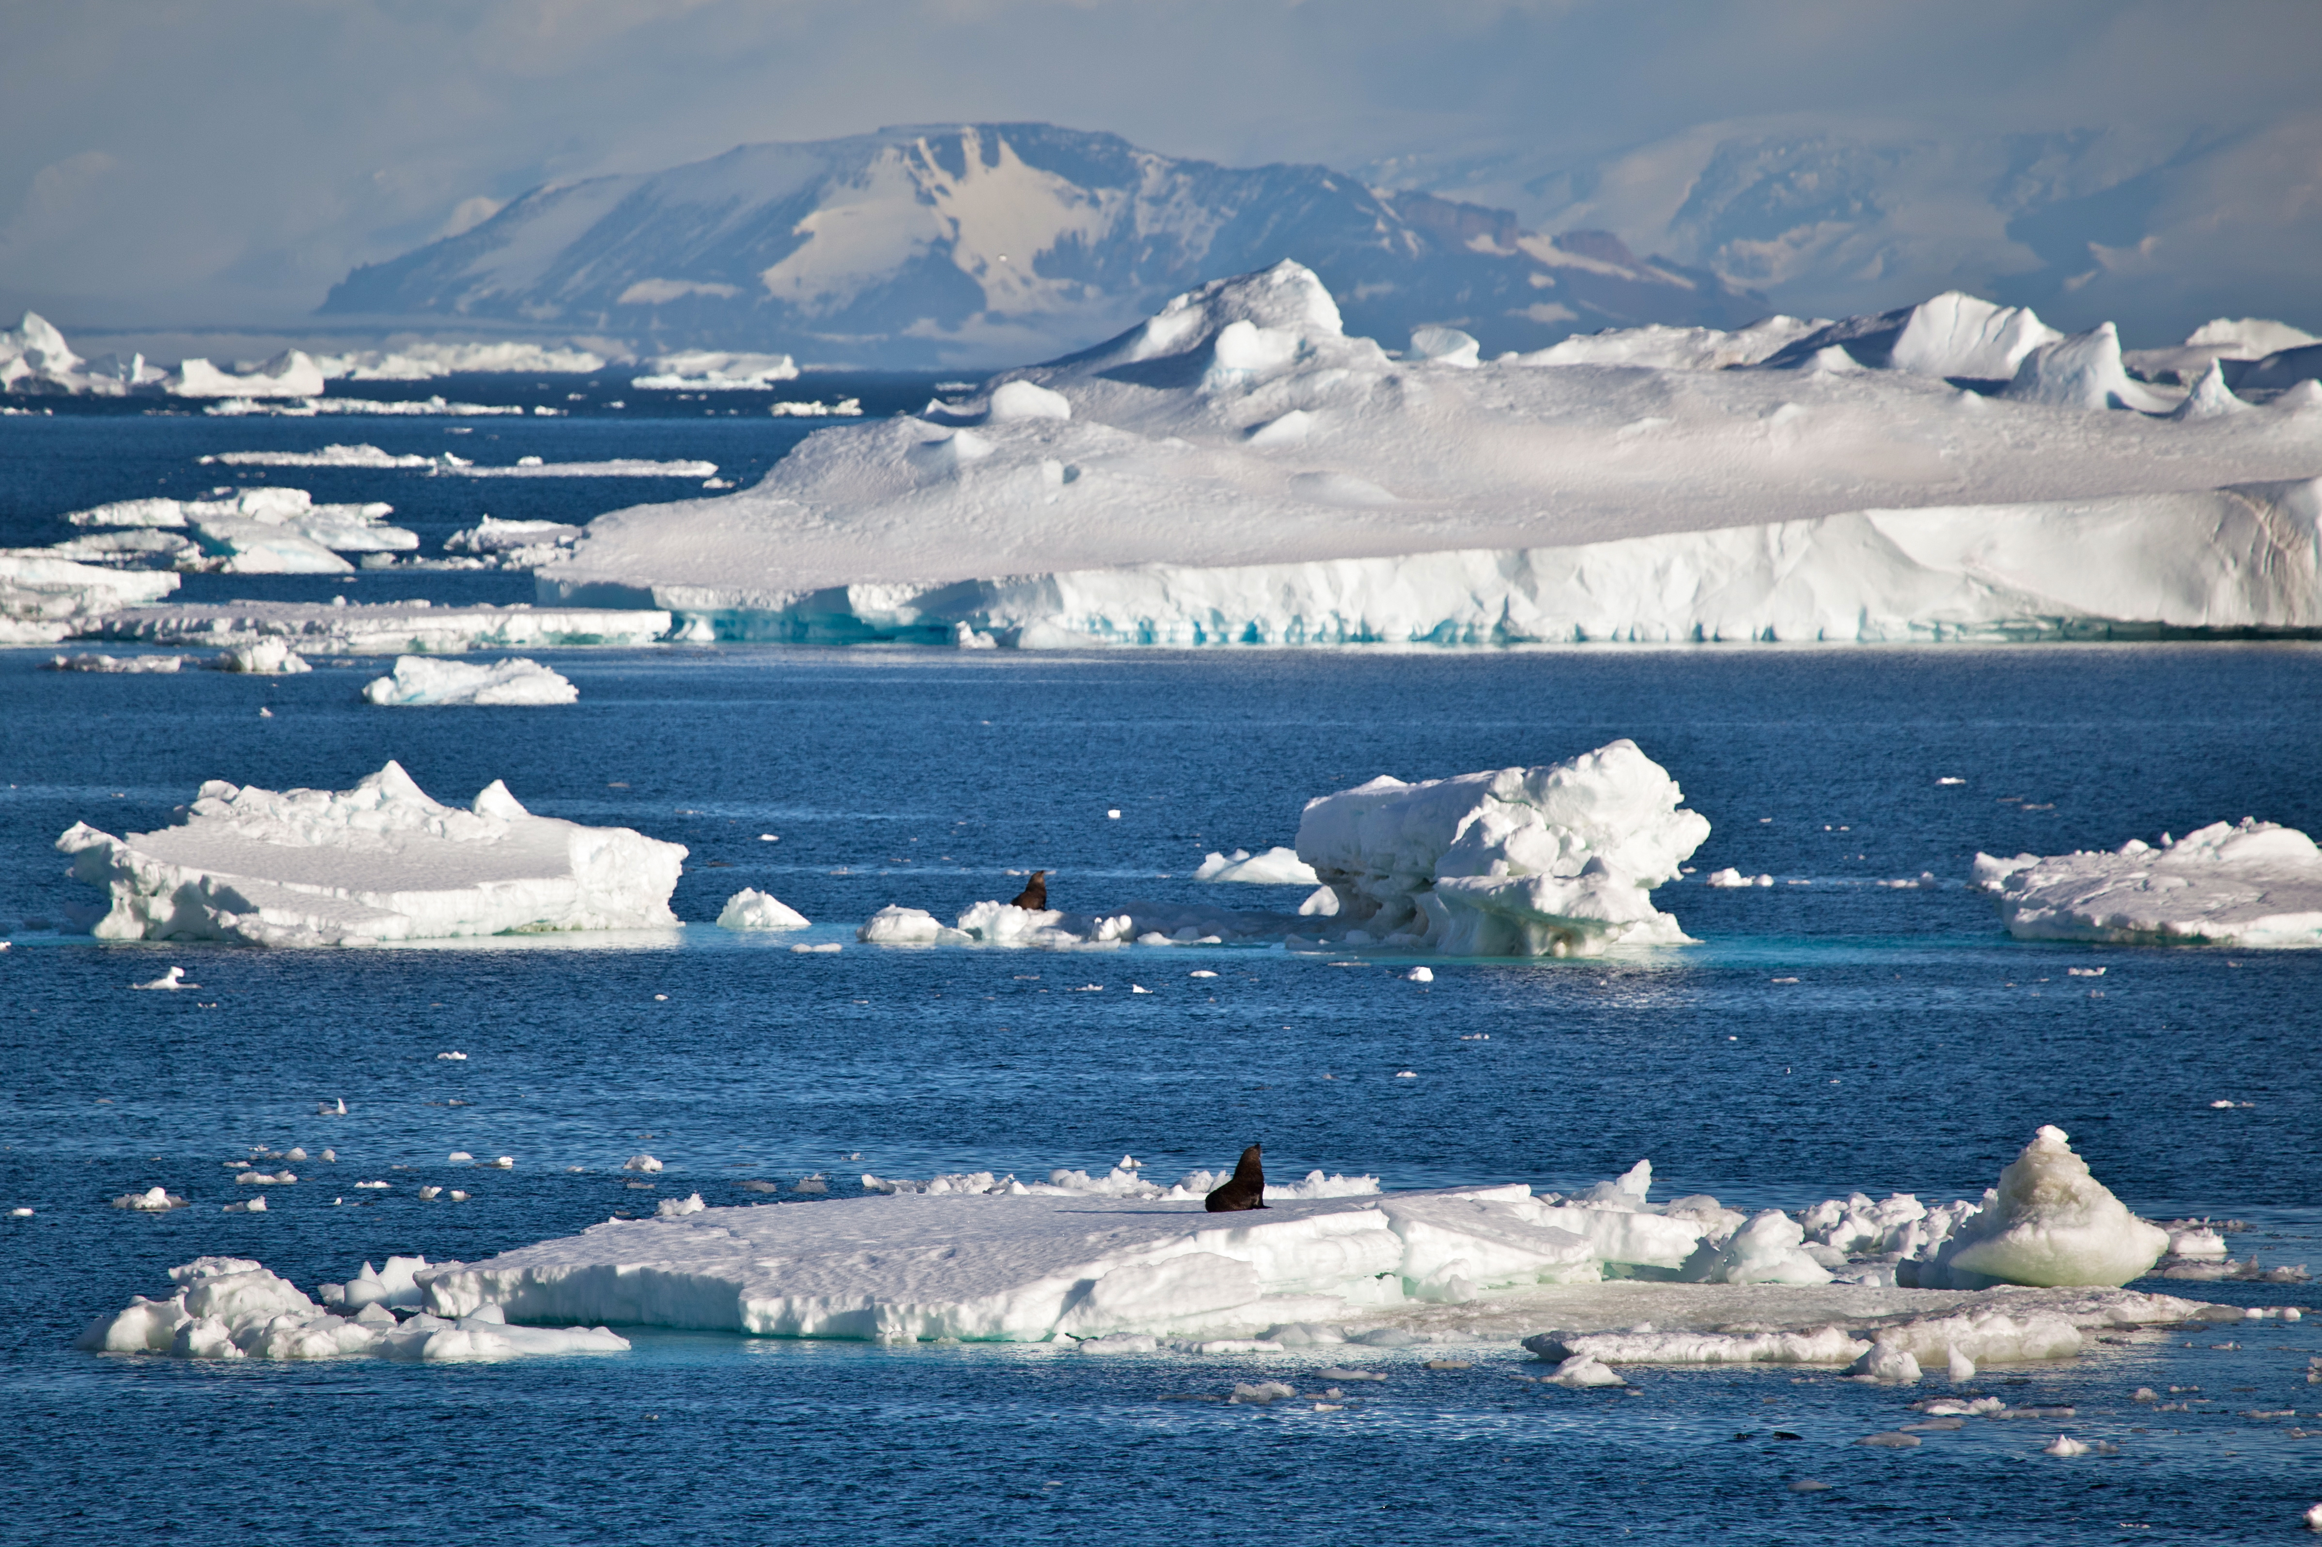
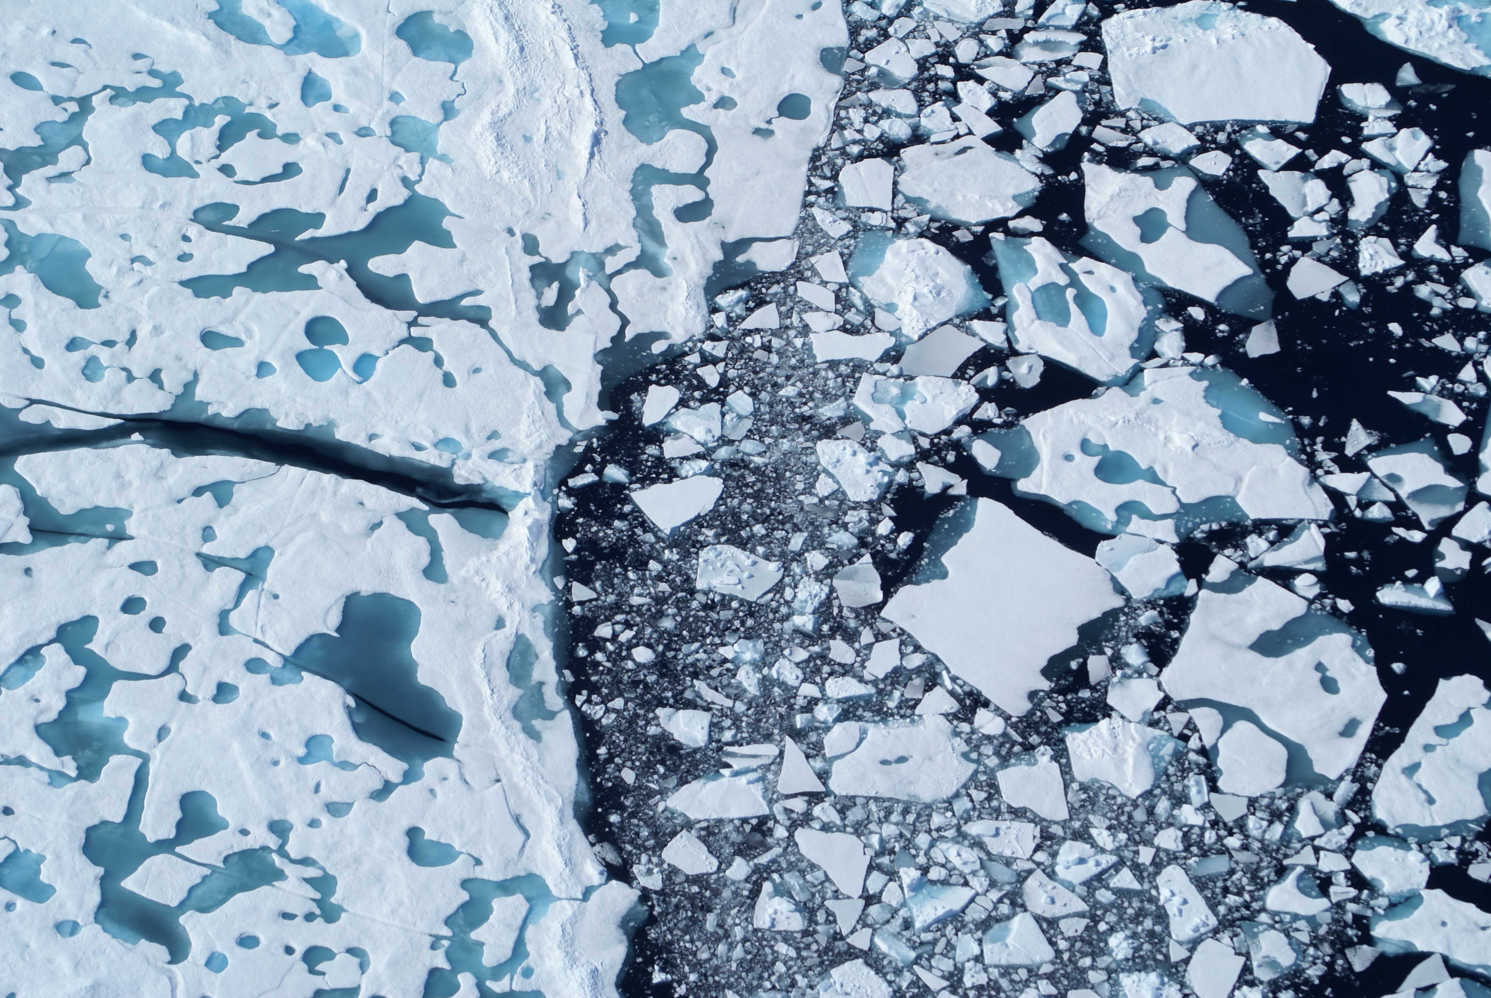
What is the Partnered Research Program?
Bridging and leveraging diverse knowledge to better understand and prepare for a changing Arctic.
Scientific collaboration between ArcticNet, Inuit Tapiriit Kanatami, Polar Knowledge Canada
Engaging Indigenous and Northern partners
4
4

Slide 5
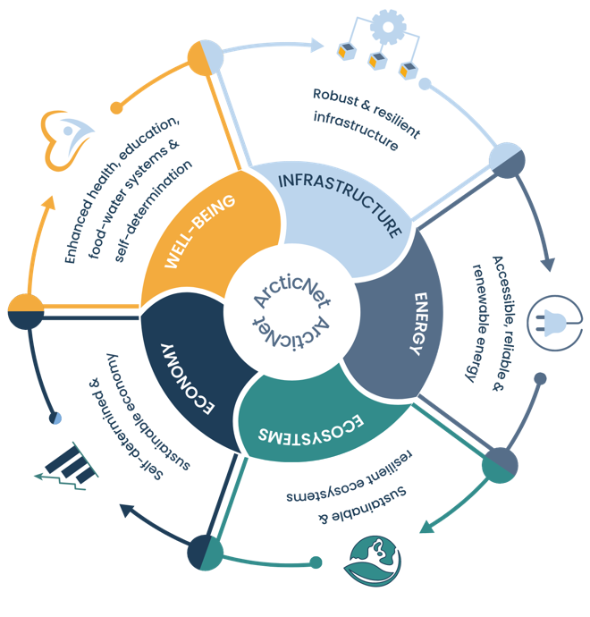
Themes of the Partnered Research Program

Slide 6
Who can apply?
Post-secondary institutions;
Research hospitals;
First Nations, Inuit and Métis and Territorial organizations and governments;
Research networks;
Public engagement networks;
Companies that deliver public engagement activities;
Start-up companies (including those housed in Canadian post-secondary-linked incubators).
Note : Eligible recipients do not include federal departments, agencies or crown corporations of the Government of Canada.

Slide 7
Geographic Scope
Project must be carried out in the Canadian Arctic and North.
Western and
Central Arctic
Eastern Arctic
Western Subarctic
Eastern Subarctic
Hudson Bay

Slide 8
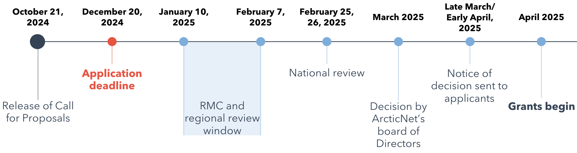
Timeline and key dates

Slide 9
Application Process
  Go to https://arcticnet.smapply.ca/prog/partnered_research_program/
  Click on “Apply”
  Log in or Register
  Complete three forms : Eligibility, Application, Self-Identification
  Language : proposals accepted in English, Inuktut and French.

Slide 10
What is a complete application?
Procedure
A complete application consists of:
  Application
  Budget
  Project Team
  Proposed Co-Investigators’ Curriculum Vitae (CVs)
  Community engagement form or letters of support (no max) from local organisations of the proposed project. Letters of support are mandatory for organizations providing cash and in-kind support.
✓
✓
✓
✓
✓

Slide 11
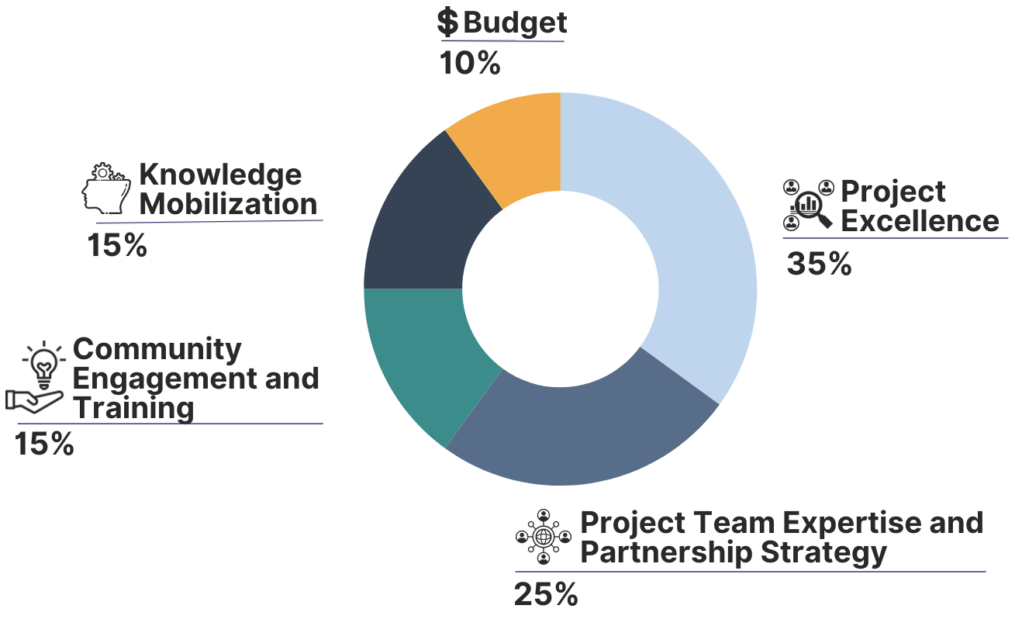
Evaluation criteria
Proposals must score a minimum of 70 points out of 100 to be considered for funding.

Slide 12





Evaluation criteria
Elements of a strong proposal
  Cash and in-kind contributions equal to or exceed ArcticNet’s average leveraging ratio of 3X
  Significant portion of the project’s budget is dedicated to Highly Qualified Personnel, training, and capacity building
  Incorporation of indigenous knowledge and/or Indigenous team members
  Include international collaborators
  Connect to and furthers existing or previous ArcticNet projects

Slide 13
Budget
From April 1, 2025 to March 31, 2028
Three annual budgets ranges:
Small projects: $25,000 to $75,000 per project
Medium projects: $75,000 to $200,000 per project
Large projects: $200,000 to $400,000 per project
Letters of support are mandatory for organizations providing cash or/and in-kind support.

Slide 14
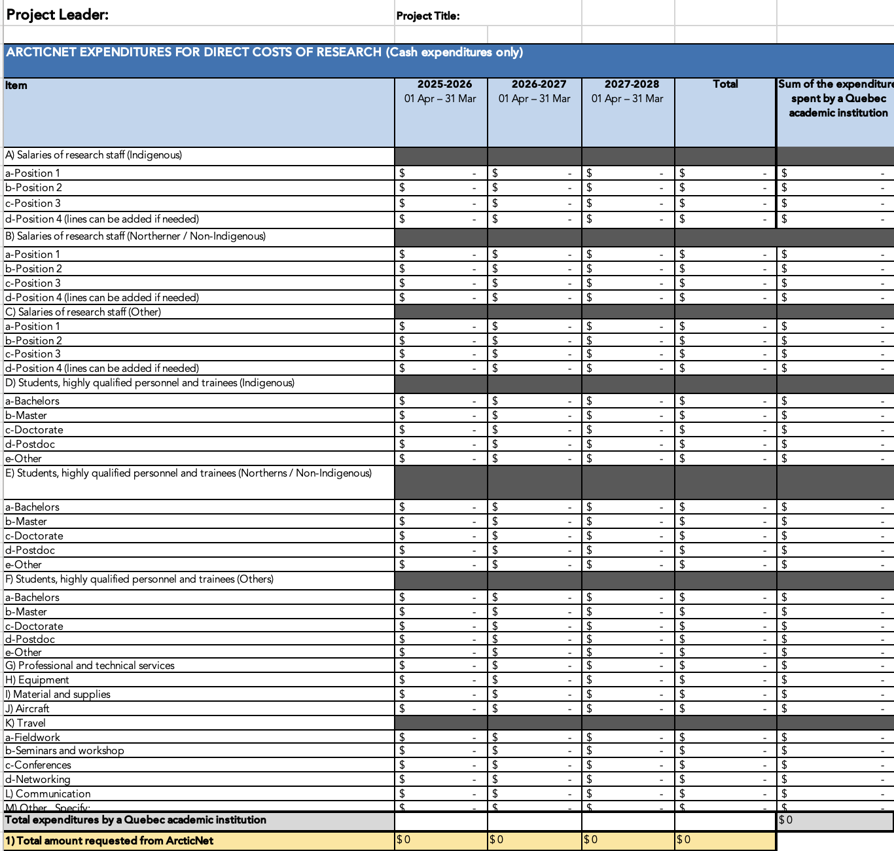
Budget

Slide 15
Budget

Slide 16
Génome Québec Partnership
Génome Québec will provide a minimum of $50,000 per year per project.
For researchers based in an eligible institution in Québec (university, college or an institution with a research mandate) but research can take place outside of Québec and Nunavik
For projects that will use omics approaches and contribute to ArcticNet pillars and Genome Quebec domains of interest.
For Project with a total Quebec-based budget of MINIMUM 200,000$
GQ will match expenses from ArcticNet or other eligible partners spend in Quebec.
Expenses does not have to be related to ”omics”.
See Génome Québec financial guidelines for more details

Slide 17
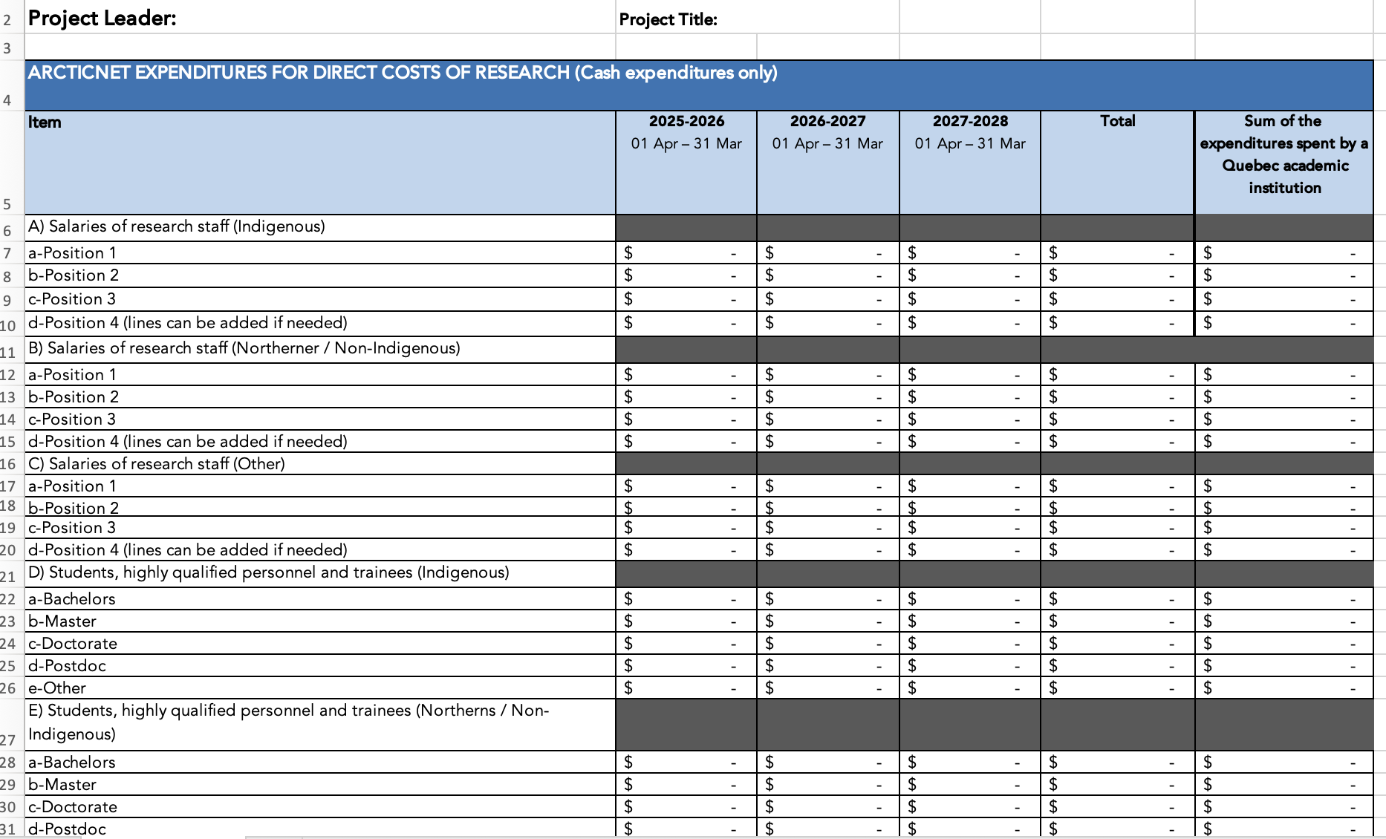
Génome Québec Partnership

Slide 18


Resources & Support for Applicants
Resources
Application Guidelines
ArcticNet’s Resources (Knowledge Mobilization, Data Management, SIKU)
FAQs
Support from
Science Program Officer : anne-laure.agrinier@arcticnet.ulaval.ca ; book a meeting here
Knowledge Mobilization Coordinator : melody.lynch@arcticnet.ulaval.ca
Inuit Research Advisors (IRAs)

Slide 19
Q&A Session
How to ask questions :
Put your questions in the chat
Raise your hand

